Slide 1

12:34
12:39
12:49
12:52

Slide 2




Slide 4

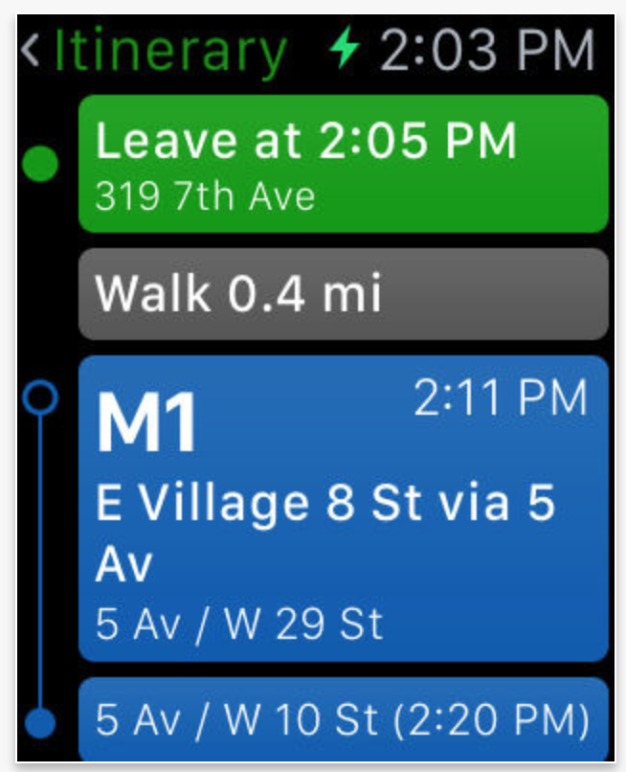


Slide 5


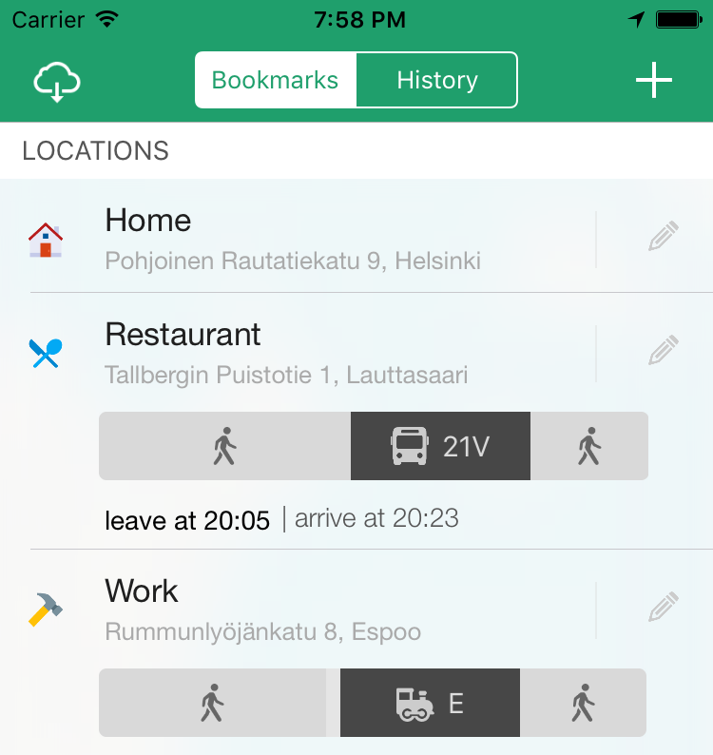

Slide 6



Slide 7


Slide 8








Slide 11


Slide 12
Helsinki 12:30
http://www.fontspace.com/category/thin?p=2
http://www.fontspace.com/nimavisual/trench

Slide 13




Slide 14





Slide 17






Slide 18
M

Slide 19


Slide 20



Slide 21


Slide 30



Slide 31


Slide 33








Slide 34





Slide 35


Ewket Apps
®
Ewket Apps
®

Slide 36










Slide 38




Slide 39


Slide 40



Slide 42



Slide 44


Slide 45
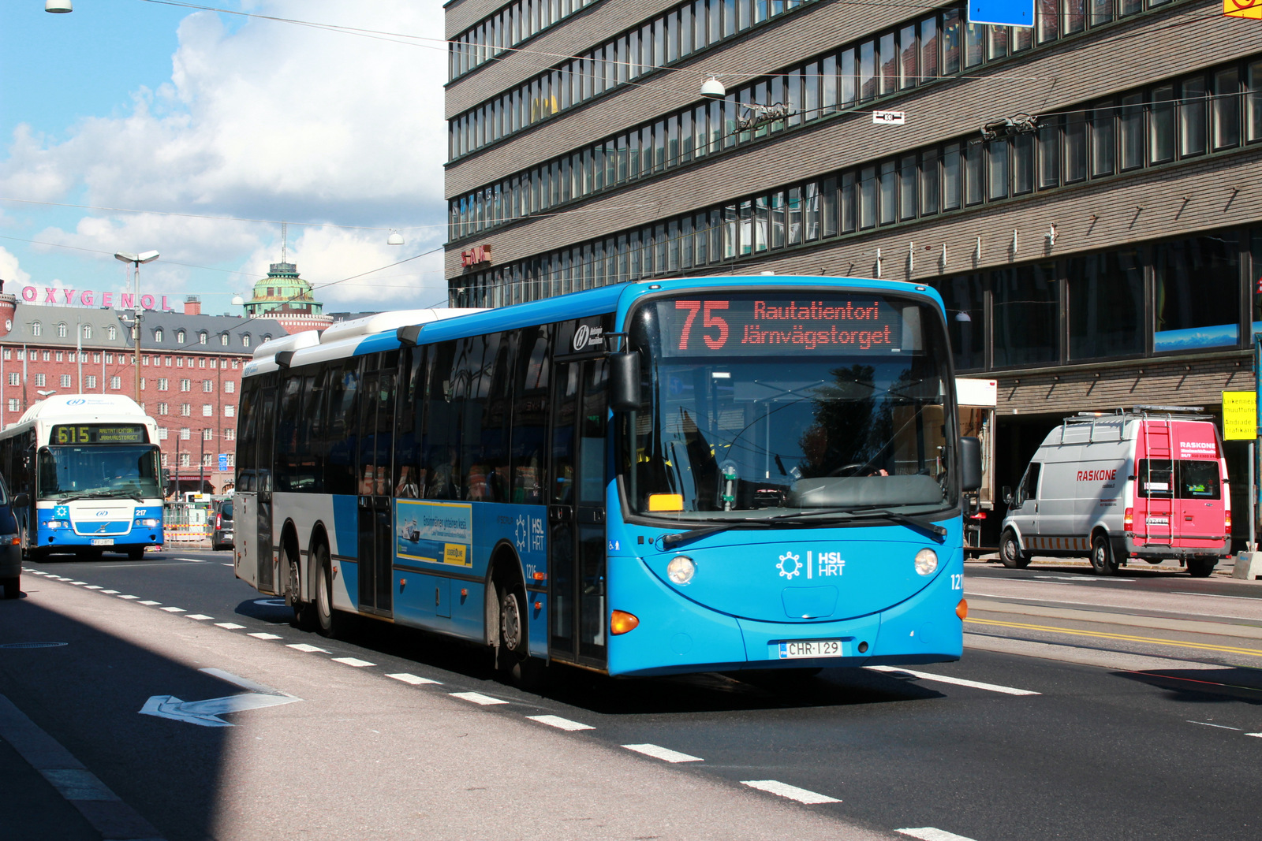

Slide 46


Slide 47


Slide 49
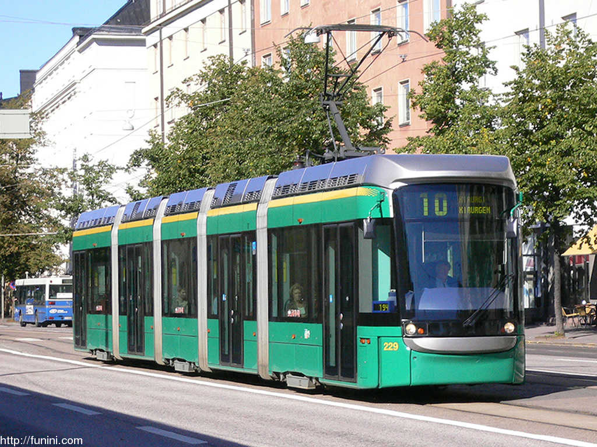

Slide 51


Slide 53
C
B
A - > C
B -> X
X = (b * C)/A
Dif = (A – B)/2
A
C * (1 – B/A)/2

